Slide 1

Welcome!
Sunday
  Bible Study 9:30 AM
  Worship 10:30 AM
Wednesday
  Bible Class 7:00 PM
www.SunsetchurchofChrist.net

Slide 2
John 8:21-30
Jesus reveals His goal
Belief in Jesus
Speaking from the Father

Slide 3
Welcome!
Sunday
  Bible Study 9:30 AM
  Worship 10:30 AM
Wednesday
  Bible Class 7:00 PM
www.SunsetchurchofChrist.net

Slide 4

Opening Prayer | Anthony Ward
Song – | Grant Haines
Scripture Reading | Michael Hetzer
Song – | Grant Haines
Song – | Grant Haines
Lord’s Supper | Michael Hetzer / Lamar McDonald
Song – | Grant Haines
Collection | Michael Hetzer / Lamar McDonald
Song – | Grant Haines
Lesson | Brian Haines
Song – | Grant Haines
Closing | Ryan Sollars

Slide 5
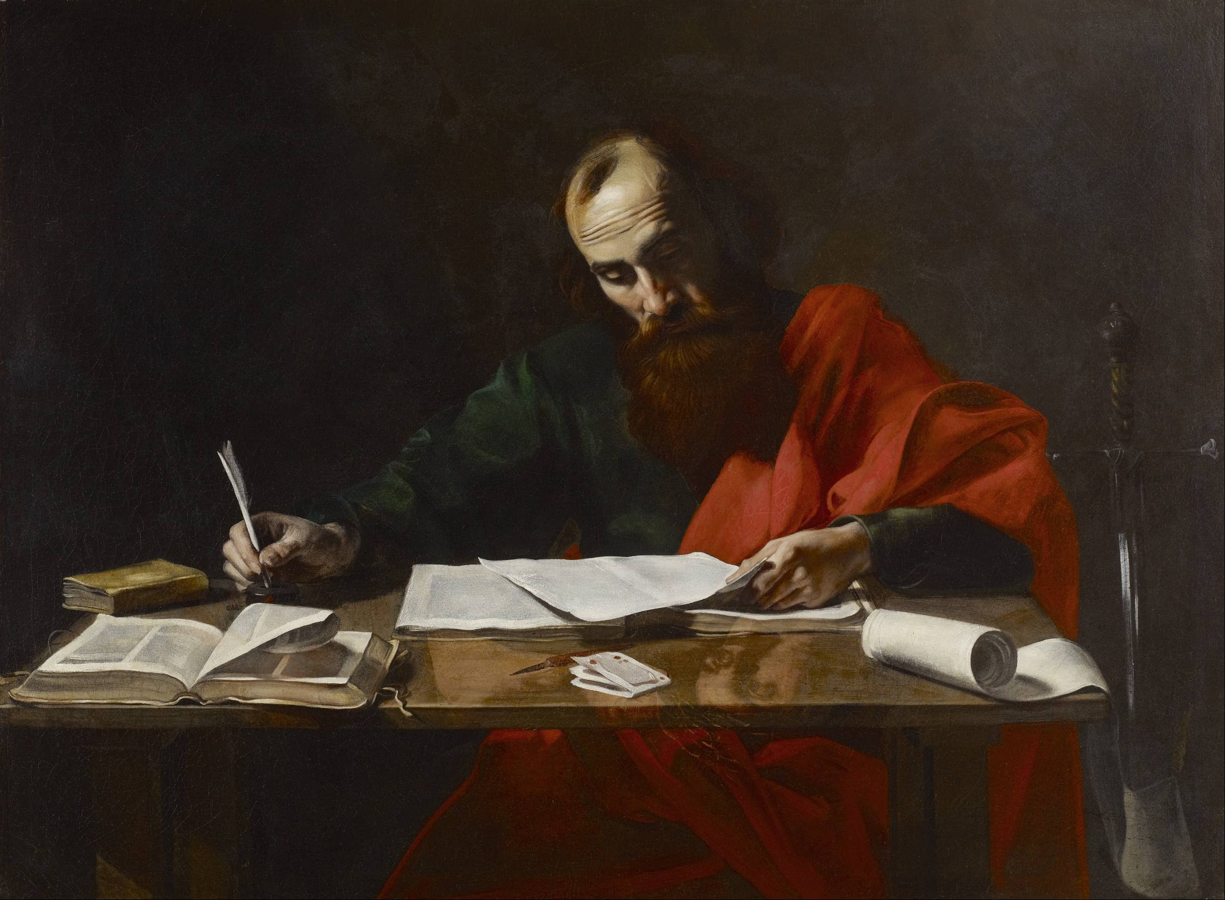
Paul’s Corinthian Advice
1 Corinthians 6
Abstinence from Sin
Notes:
Begin reading at vs. 15

Slide 6
Paul’s Concerns
Tolerating sinful living among them
Are they sinfully living themselves?
They can lose the inheritance!

Slide 7
The Inheritance
Israelite inheritance: Canaan’s Land
For the LORD will greatly bless you in the land which the LORD your God is giving you to possess as an inheritance Deuteronomy 15:4b

Slide 8
The Inheritance
Our inheritance: Eternal life with God
Promised 1st to Abraham – Galatians 3:18
Guaranteed by Jesus – Ephesians 1:14
Qualified by adoption – Colossians 1:12
Notes:
Ga 3:18 For if the inheritance is of the law, it is no longer of promise; but God gave it to Abraham by promise.
Eph 1:14 who is the guarantee of our inheritance until the redemption of the purchased possession, to the praise of His glory.
Col 1:12 ¶ giving thanks to the Father who has qualified us to be partakers of the inheritance of the saints in the light.

Slide 9
The Inheritance
Our inheritance: Eternal life with God
Promised 1st to Abraham – Galatians 3:18
Guaranteed by Jesus – Ephesians 1:14
Qualified by adoption – Colossians 1:12
Notes:
Ga 3:18 For if the inheritance is of the law, it is no longer of promise; but God gave it to Abraham by promise.
Eph 1:14 who is the guarantee of our inheritance until the redemption of the purchased possession, to the praise of His glory.
Col 1:12 ¶ giving thanks to the Father who has qualified us to be partakers of the inheritance of the saints in the light.

Slide 10
Losing the Inheritance
Do you not know that the unrighteous will not inherit the kingdom of God?

Slide 11
Losing the Inheritance
Do you not know that the unrighteous will not inherit the kingdom of God?
Unrighteous – those who are not right by the standard that God has established

Slide 12
Losing the Inheritance
Do you not know that the unrighteous will not inherit the kingdom of God?
those who practice (works of the flesh) will not inherit the kingdom of God. Galatians 5:21b

Slide 13
Losing the Inheritance
Do you not know that the unrighteous will not inherit the kingdom of God?
For this you know, that no fornicator, unclean person, nor covetous man, who is an idolater, has any inheritance in the kingdom Ephesians 5:5

Slide 14
Losing the Inheritance
If you are living in sin, there is no inheritance
Sinning vs. living in sin
If we confess our sins, He is faithful and just to forgive us our sins and to cleanse us from all unrighteousness. 1 John 1:9

Slide 15
Losing the Inheritance
If you are living in sin, there is no inheritance
Sinning vs. living in sin
The deceptive nature of sin
Temptation and desire – James 1:13-15
There is always a penalty – Galatians 6:7
Notes:
Jas 1:13 ¶ Let no one say when he is tempted, "I am tempted by God"; for God cannot be tempted by evil, nor does He Himself tempt anyone.
14 But each one is tempted when he is drawn away by his own desires and enticed.
15 Then, when desire has conceived, it gives birth to sin; and sin, when it is full-grown, brings forth death.

Slide 16
Losing the Inheritance
Works of the flesh
Neither fornicators, nor idolaters, nor adulterers, nor homosexuals, nor sodomites, nor thieves, nor covetous, nor drunkards, nor revilers, nor extortioners……
Notes:
Ga 5:19 Now the works of the flesh are evident, which are: adultery, fornication, uncleanness, lewdness, 20 idolatry, sorcery, hatred, contentions, jealousies, outbursts of wrath, selfish ambitions, dissensions, heresies, 21 envy, murders, drunkenness, revelries, and the like; of which I tell you beforehand, just as I also told you in time past, that those who practice such things will not inherit the kingdom of God.

Slide 17
Works of the Flesh
Fornicators
Adulterers
Homosexuals
Sodomites

Slide 18
Works of the Flesh
Fornicators
Adulterers
Homosexuals
Sodomites
Idolaters
Thieves
Covetous
Extortioners

Slide 19
Works of the Flesh
Fornicators
Adulterers
Homosexuals
Sodomites
Idolaters
Thieves
Covetous
Extortioners
Drunkards
Revilers

Slide 20
Such Were You……
Fornicators
Adulterers
Homosexuals
Sodomites
Idolaters
Thieves
Covetous
Extortioners
Drunkards
Revilers

Slide 21
Such Were You……
You were washed – Baptized
Cleansed of sin
Born again
Adopted by Grace

Slide 22
Such Were You……
You were washed – Baptized
You were sanctified – Made Holy
Your body is now a Temple of God
His Spirit makes you alive
You must maintain its sanctitiy

Slide 23
Such Were You……
You were washed – Baptized
You were sanctified – Made Holy
You were justified – Made right before God
Literally – acquittal of charges
By the righteousness of Jesus

Slide 24
Therefore
Do not return to the reason you were lost
God cannot exist with sinfulness
Constantly seek to purify yourselves

Slide 26
